Slide 1
DATA SCRAPING
GROUP NO:- 85
SEMINAR GUIDE:- JALPA KHAMAR
-KISHAN PATEL
-DIVY PATEL

Slide 2
Data Scraping is the process of importing information from a website into a spreadsheet or local file saved on your computer.

Slide 3
DATA SCRAPING
It’s one of the most efficient ways to get data from the web, and in some cases to channel that data to another website. Popular uses of data scraping include:
Research for web content/business intelligence
Pricing for travel booker sites/price comparison sites
Finding sales leads/conducting market research by crawling public data sources (e.g. Yell and Twitter)

Slide 4
WEB SCRAPING
The DATA SCRAPING is Also Known As WEB SCRAPING

Slide 5
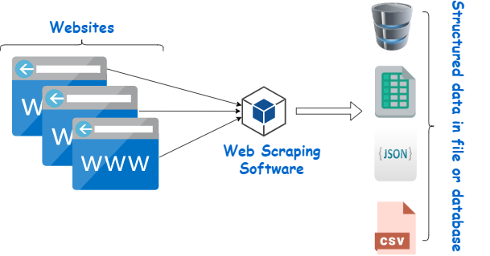
BASICALLY
It is Transformation of Unstructured data on web (HTML formate) into Structured data that can be analyzed (Like CSV, JSON).

Slide 6
USE OF DATA SCRAPING

Slide 7
FOLLOWING ARE SOME OF USE OF DATA SCRAPING
Online Price Comparison
Contact Scraping
Weather Data Monitoring
Website Change Detection
To Collect Data’s for Research Work
Scraping articles blog and content
Social Media Crawling
Crawling Review Data

Slide 8
TOOLS THAT CAN USED FOR SCRAPING

Slide 9
TWO TYPES OF TOOLS
POINT AND CLICK
There are some tools that can provide you the Data by just Click on the Website. Like
Scraper Google Chrome Extension
ScraperWiKi
Import.io
Webscraper.io
USING PROGRAMMING
There are Some Modules that You can use in Programing to Scrape the data easily.
Beautiful Soup
Scrapy

Slide 10
SOME EXAMPLE OF DATA SCRAPING

Slide 11
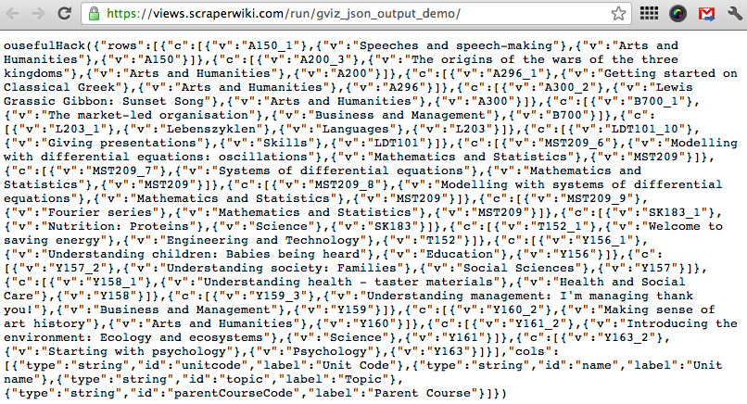
SCRAPERWIKI
It is Online Tool That can Scrape Data Easily by just one Click and Provide you Data that can be analyzed.
Here in We extracted List of Book Name.

Slide 12
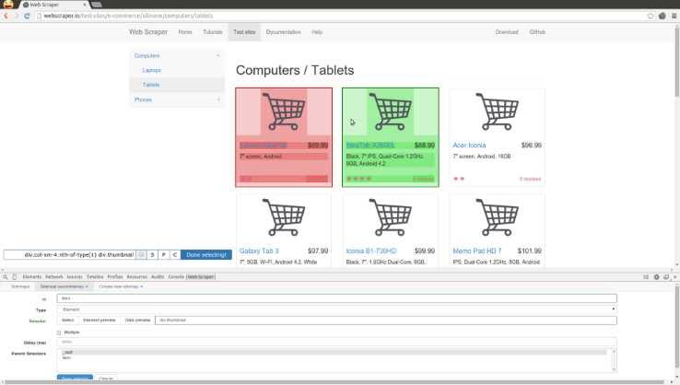
WEBSCRAPER.IO
In this example we selected the list of product with the help of webscraper.io

Slide 13
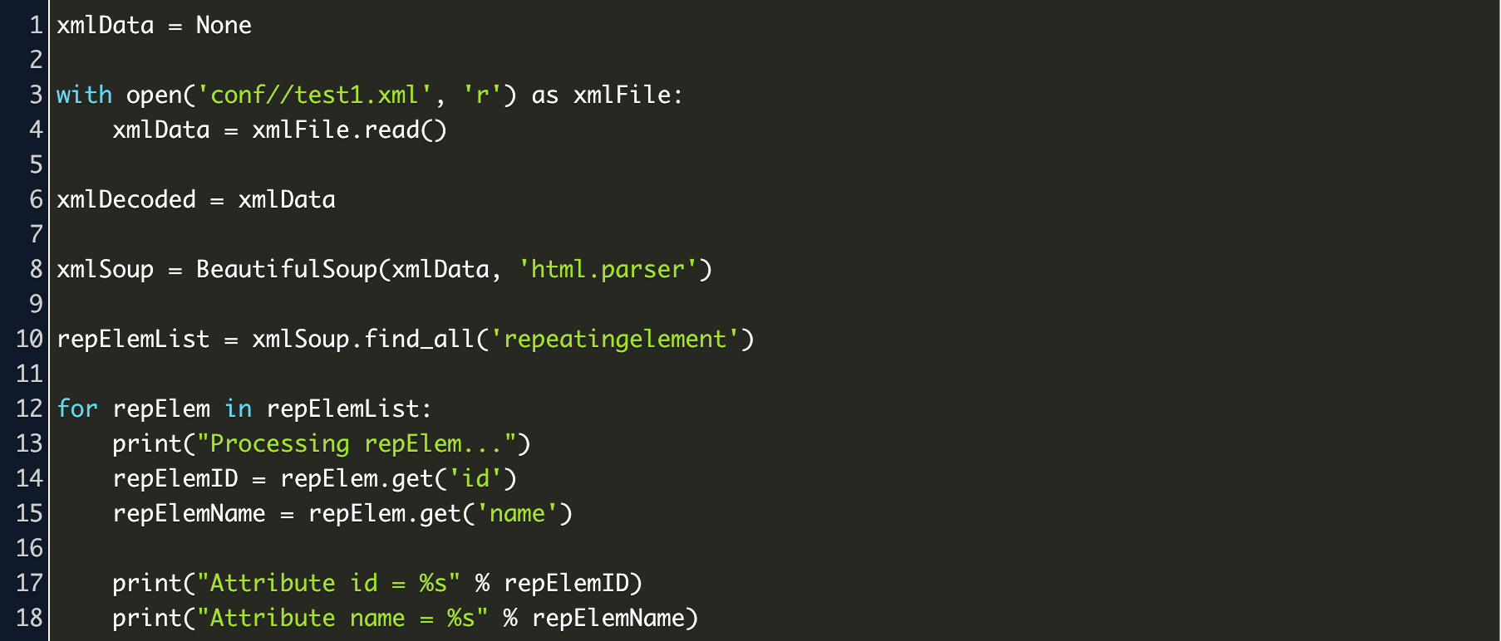
BEAUTIFUL SOUP
In here, we find the Attribute that are have class name of ‘repeatingelement’ in the html.

Slide 14
ADVANTAGE
Data Accuracy
Easy to Implement
Low Maintenance and Speed
Webscraper.io
DISADVANTAGE
Website Regularly Change their Structure and Crawlers Require Maintenance
IP Detection

Slide 15
CONCLUSION
The Data Scraping is Very useful when you need to analyze the site’s Data and convert them into the CSV or use it for your project database.

Slide 16
THANKS!

